Slide 1
AVR Microcontroller
Microprocessor Course
Chapter 5
ARITHMATIC,LOGIC INSTRUCTIONS AND PROGRAMS
Aban 1401

Slide 2
ARITHMATIC, LOGIC INSTRUCTIONS AND PROGRAMS 5.1 ARITHMATIC INSTRUCTIONS
Unsigned numbers are defined as data in which all the bits are used to represent data and no bits are set aside for the positive or negative sign. This means that the operand can be between 00 and FFH (0 to 255 decimal) for 8-bit data.
Addition of unsigned numbers
In the AVR, the add operation has two general purpose registers as inputs and the result will be stored in the first (left) register. One form of the ADD instruction in the AVR is:
ADD Rd,Rr ;Rd = Rd + Rr
It could change any of the Z, C, N, V, H or S bits of the status register, depending on the operands involved.
Notes:
Notice that none of the AVR addition instructions support direct memory access; that is, we cannot add a memory location to another memory location or register.

Slide 3
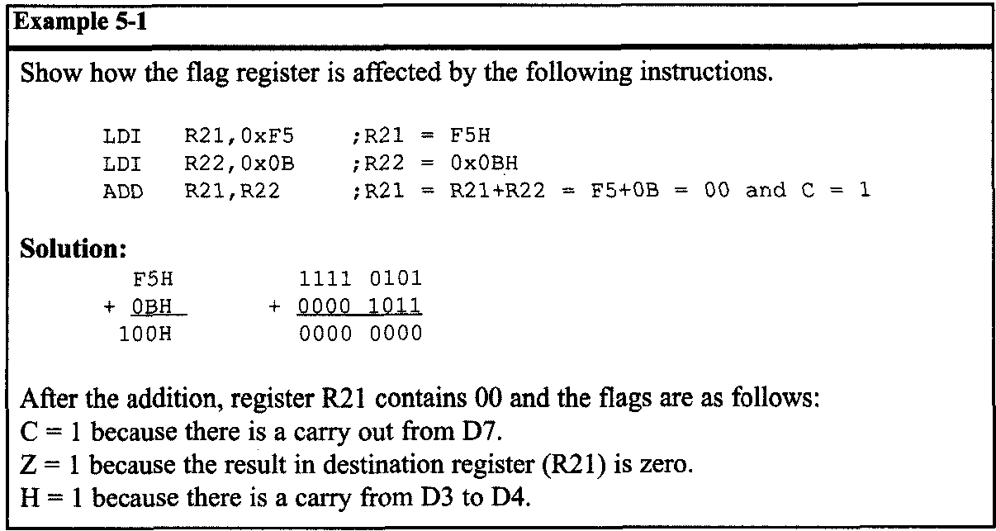
ARITHMATIC, LOGIC INSTRUCTIONS AND PROGRAMS 5.1 ARITHMATIC INSTRUCTIONS

Slide 4
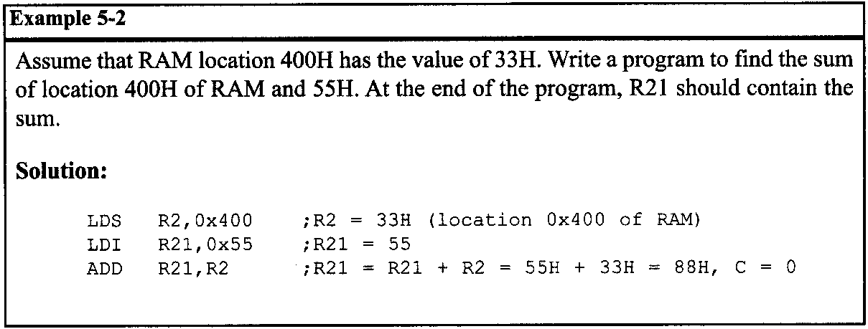
ARITHMATIC, LOGIC INSTRUCTIONS AND PROGRAMS 5.1 ARITHMATIC INSTRUCTIONS

Slide 5
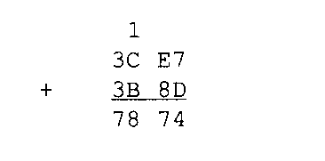
ARITHMATIC, LOGIC INSTRUCTIONS AND PROGRAMS 5.1 ARITHMATIC INSTRUCTIONS
ADC and addition of 16-bit numbers
When adding two 16-bit data operands, we need to be concerned with the propagation of a carry from the lower byte to the higher byte. This is called multibyte addition to distinguish it from the addition of individual bytes. The instruction ADC (ADD with carry) is used on such occasions.
For example, look at the addition of 3CE7H + 3B8DH, as shown next.
When the first byte is added, there is a carry (E7 + 8D = 74, C = 1). The carry is propagated to the higher byte, which results in 3C + 3B + 1 = 78 (all in hex).

Slide 6
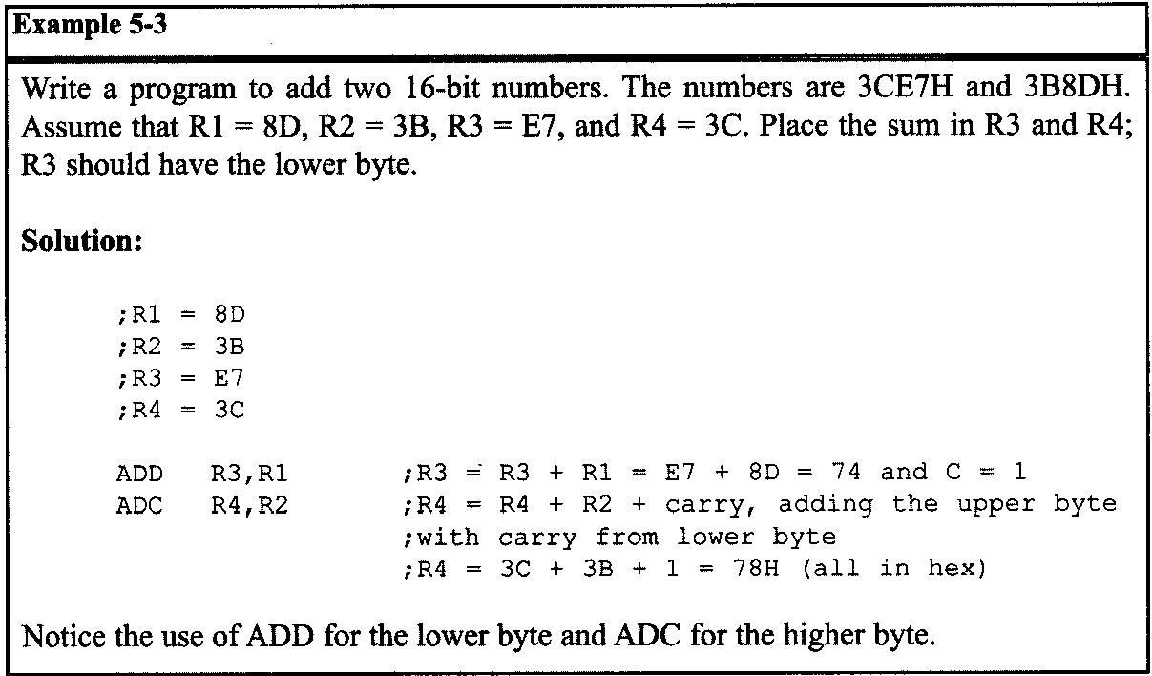
ARITHMATIC, LOGIC INSTRUCTIONS AND PROGRAMS 5.1 ARITHMATIC INSTRUCTIONS

Slide 7
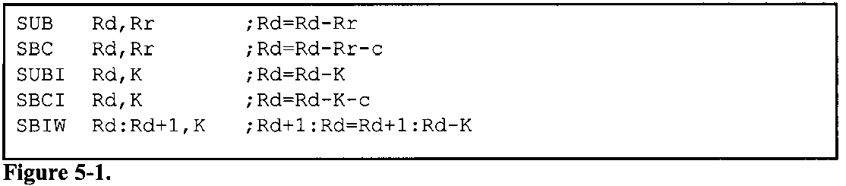
ARITHMATIC, LOGIC INSTRUCTIONS AND PROGRAMS 5.1 ARITHMATIC INSTRUCTIONS
Subtraction of unsigned numbers
In many microprocessors, there are two different instructions for subtraction: SUB and SUBB (subtract with borrow). In the AVR we have five instructions for subtraction: SUB, SBC, SUBI, SBCI, and SBIW.
The SBC and SBCI instructions are subtract with borrow. In the AVR, we use the C (carry) flag for the borrow and that is why they are called SBC (SUB with Carry).

Slide 8
ARITHMATIC, LOGIC INSTRUCTIONS AND PROGRAMS 5.1 ARITHMATIC INSTRUCTIONS
SUB Rd,Rr (Rd = Rd - Rr)
In subtraction, the AVR microcontrollers use the 2's complement method. Although every CPU contains adder circuitry, it would be too cumbersome (and take too many transistors) to design separate subtractor circuitry. For this reason, the AVR uses adder circuitry to perform the subtraction command. Assuming that the AVR is executing a simple subtract instruction and that C = 0 prior to the execution of the instruction, one can summarize the steps of the hardware of the CPU in executing the SUB instruction for unsigned numbers as follows
Take the 2's complement of the subtrahend (right-hand operand).
Add it to the minuend (left-hand operand).
Invert the carry.

Slide 9
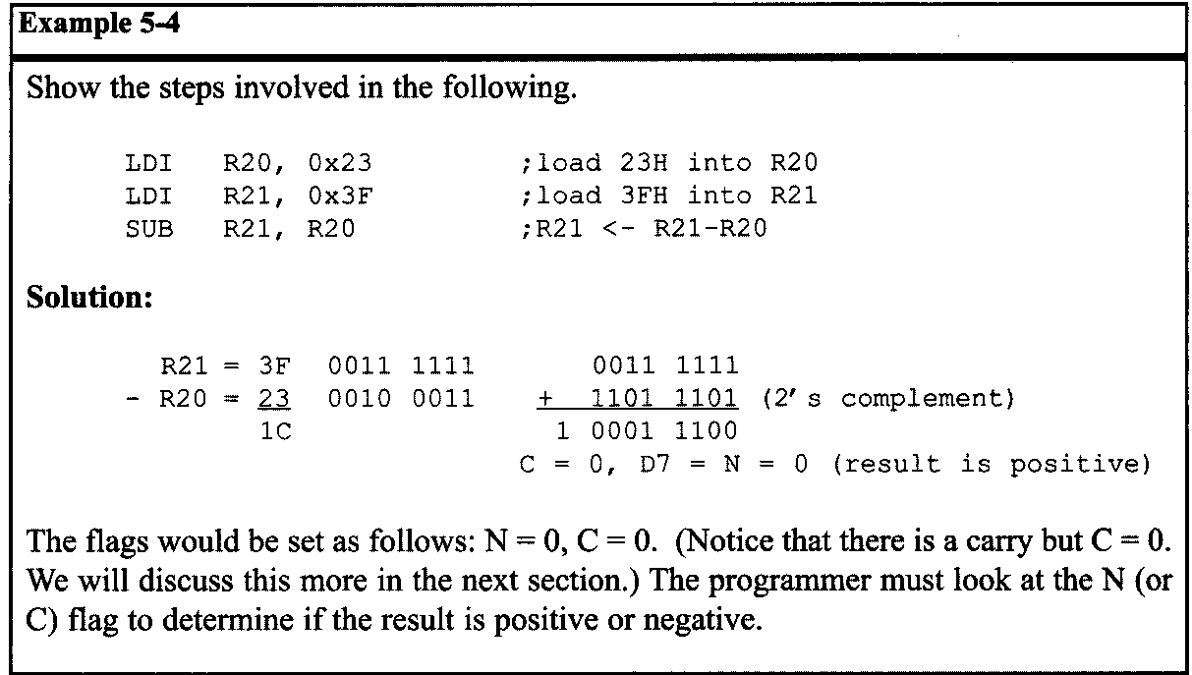
ARITHMATIC, LOGIC INSTRUCTIONS AND PROGRAMS 5.1 ARITHMATIC INSTRUCTIONS

Slide 10
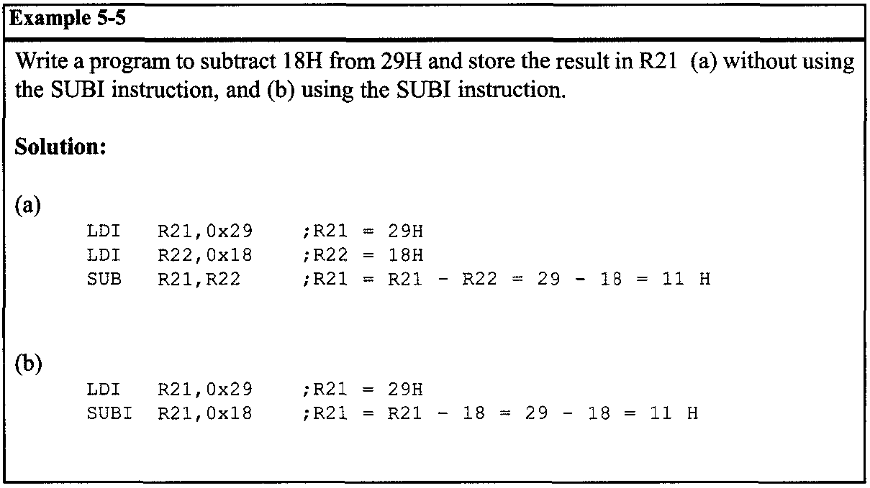
ARITHMATIC, LOGIC INSTRUCTIONS AND PROGRAMS 5.1 ARITHMATIC INSTRUCTIONS
First line of page 178

Slide 11
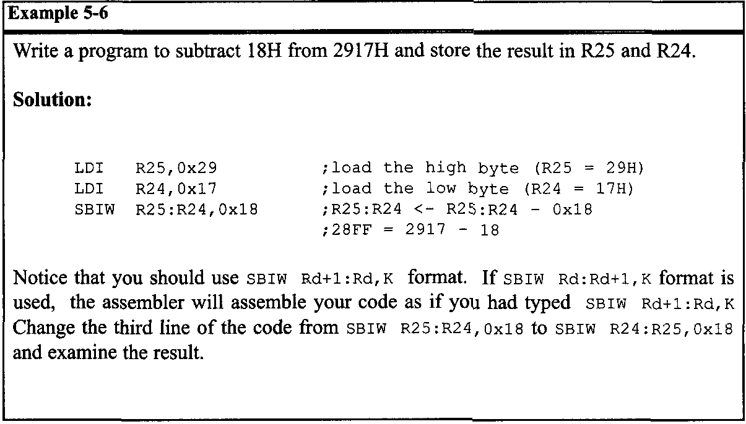
ARITHMATIC, LOGIC INSTRUCTIONS AND PROGRAMS 5.1 ARITHMATIC INSTRUCTIONS

Slide 12
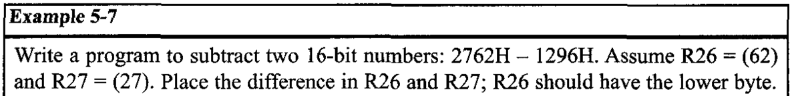
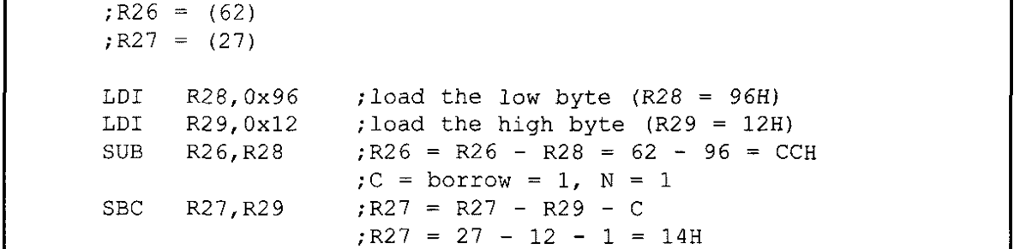
ARITHMATIC, LOGIC INSTRUCTIONS AND PROGRAMS 5.1 ARITHMATIC INSTRUCTIONS
SBC (Rd ← Rd - Rr - C) subtract with borrow (denoted by C)
This instruction is used for multibyte numbers and will take care of the borrow of the lower byte. If the borrow flag is set to one (C = 1) prior to executing the SBC instruction, this operation also subtracts 1 from the result.

Slide 13
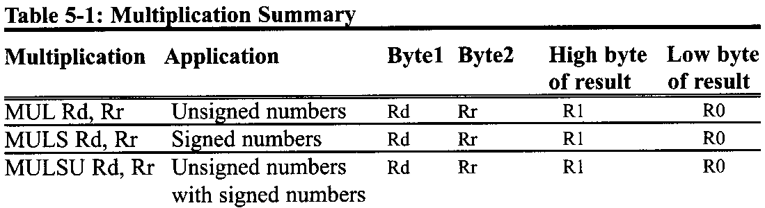
ARITHMATIC, LOGIC INSTRUCTIONS AND PROGRAMS 5.1 ARITHMATIC INSTRUCTIONS
Multiplication of unsigned numbers
The AVR has several instructions dedicated to multiplication. Here we will discuss the MUL instruction. Other instructions are similar to MUL but are used for signed numbers.
MUL is a byte-by-byte multiply instruction. In byte-by-byte multiplication, operands must be in registers. After multiplication, the 16-bit unsigned product is placed in R1 (high byte) and R0 (low byte).

Slide 14
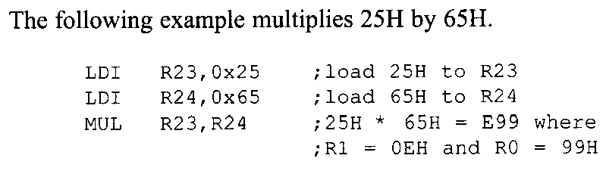
ARITHMATIC, LOGIC INSTRUCTIONS AND PROGRAMS 5.1 ARITHMATIC INSTRUCTIONS
0x25 = 37
0x65 = 1010
37 * 101 = 3737 = 0x0E99

Slide 15
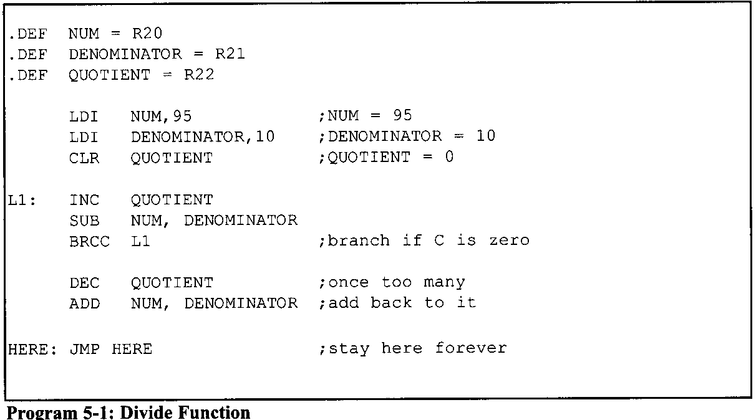
ARITHMATIC, LOGIC INSTRUCTIONS AND PROGRAMS 5.1 ARITHMATIC INSTRUCTIONS
Division of unsigned numbers
AVR has no instruction for divide operation. We can write a program to perform division by repeated subtraction.
Notes:
AVR has no instruction for divide operation. We can write a program to perform division by repeated subtraction. In dividing a byte by a byte, the numerator is placed in a register and the denominator is subtracted from it repeatedly. The quotient is the number of times we subtracted and the remainder is in the register upon completion.

Slide 16
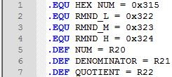
ARITHMATIC, LOGIC INSTRUCTIONS AND PROGRAMS 5.1 ARITHMATIC INSTRUCTIONS
An application for division
Sometimes a sensor is connected to an ADC (analog-to-digital converter) and the ADC represents some quantity such as temperature or pressure. The 8-bit ADC provides data in hex in the range of 00-FFH. This hex data must be converted to decimal. We do that by dividing it by 10 repeatedly, saving the remainders,
Example 5-8
Assume that the data memory location 0x315 has value FD (hex). Write a program to convert it to decimal. Save the digits in locations 0x322, 0x323, and 0x324, where the least-significant digit is in location 0x322.

Slide 17
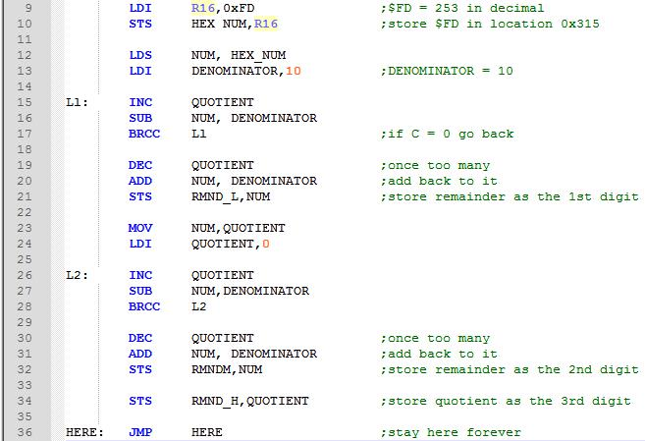
ARITHMATIC, LOGIC INSTRUCTIONS AND PROGRAMS 5.1 ARITHMATIC INSTRUCTIONS

Slide 18
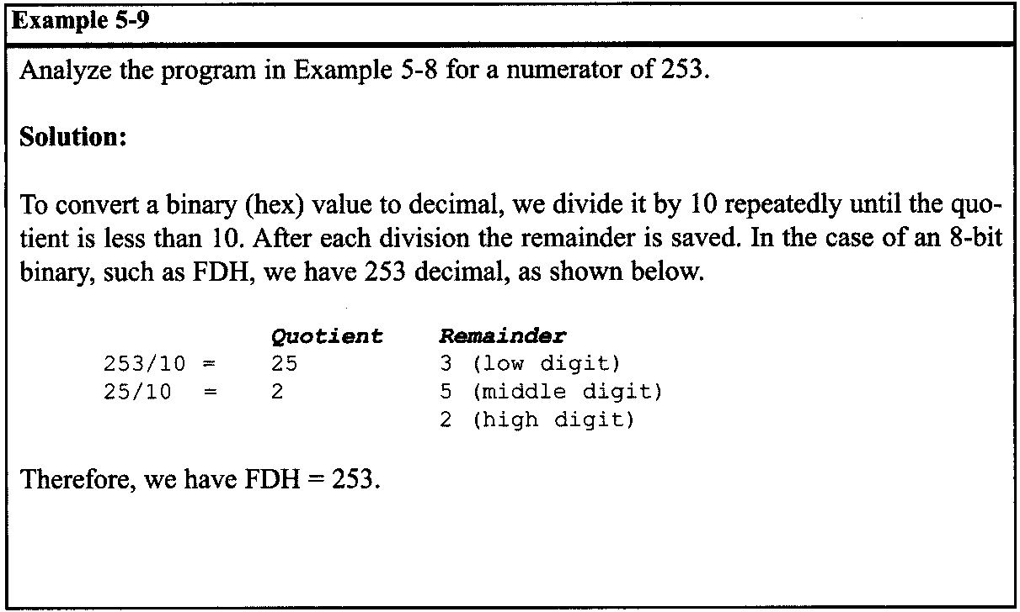
ARITHMATIC, LOGIC INSTRUCTIONS AND PROGRAMS 5.1 ARITHMATIC INSTRUCTIONS

Slide 19
ARITHMATIC, LOGIC INSTRUCTIONS AND PROGRAMS 5.2: SIGNED NUMBER CONCEPTS AND ….
5.2 SIGNED NUMBER CONCEPTS AND ARITHMETIC OPERATIONS
All data items used so far have been unsigned numbers. Many applications require signed data. In this section the concept of signed numbers is discussed along with related instructions.
Concept of signed numbers in computers
In everyday life, numbers are used that could be positive or negative. To do that, computer scientists have devised the following arrangement for the representation of signed positive and negative numbers: The most significant bit (MSB) is set aside for the sign (+ or -), while the rest of the bits are used for the magnitude. The sign is represented by 0 for positive (+) numbers and 1 for negative (-) numbers.

Slide 20
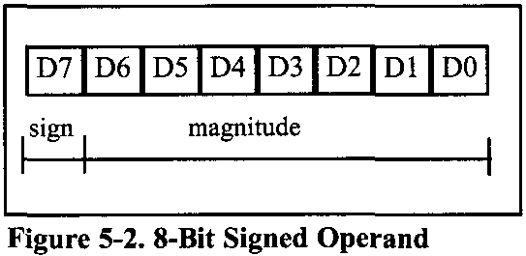
ARITHMATIC, LOGIC INSTRUCTIONS AND PROGRAMS 5.2: SIGNED NUMBER CONCEPTS AND ….
Signed bit operands
Positive numbers
The range of positive numbers that can be represented by the format shown is 0 to +127. If a positive number is larger than +127, a 16-bit operand must be used.
Negative numbers
For negative numbers, D7 is 1; however. Although the assembler does the conversion, it is still important to understand how the conversion works. To convert to negative number representation (2's complement), follow these steps:
1. Write the magnitude of the number in 8-bit binary (no sign).
2. Invert each bit.
3. Add 1 to it.

Slide 21
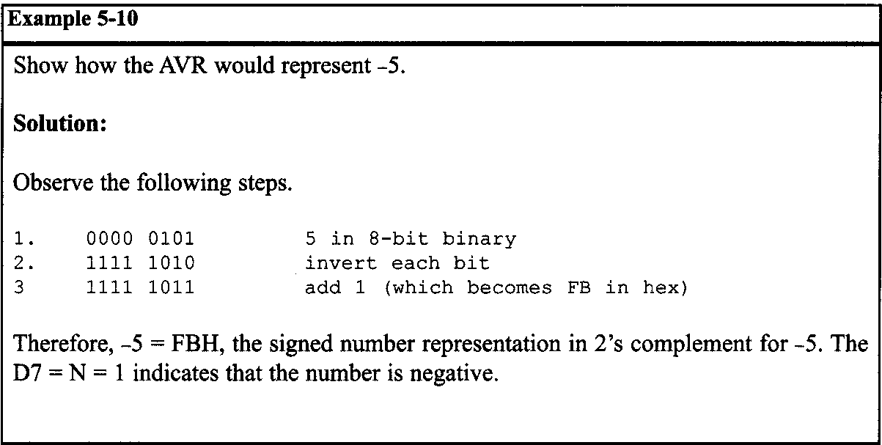
ARITHMATIC, LOGIC INSTRUCTIONS AND PROGRAMS 5.2: SIGNED NUMBER CONCEPTS AND ….

Slide 22
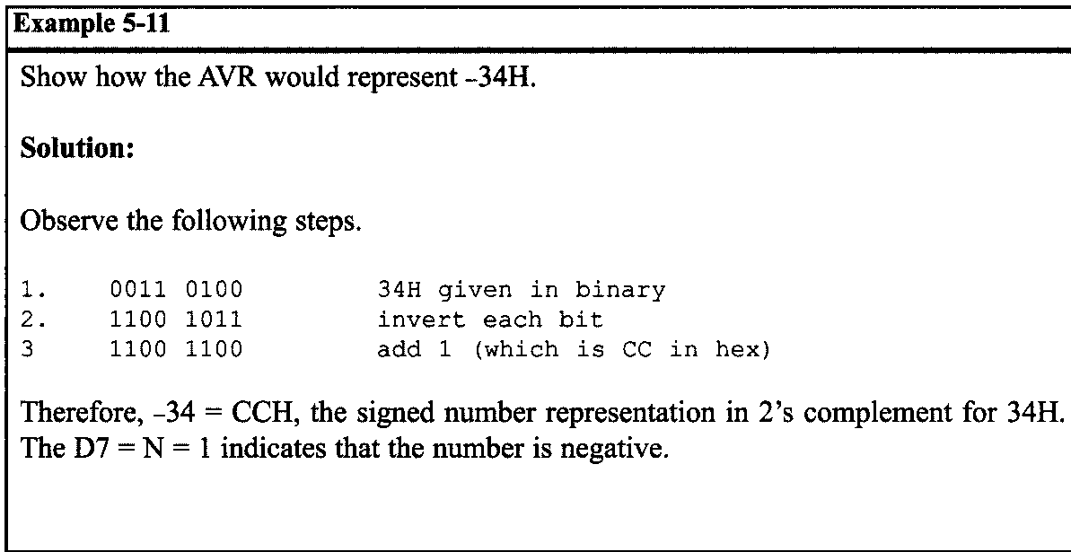
ARITHMATIC, LOGIC INSTRUCTIONS AND PROGRAMS 5.2: SIGNED NUMBER CONCEPTS AND ….

Slide 23
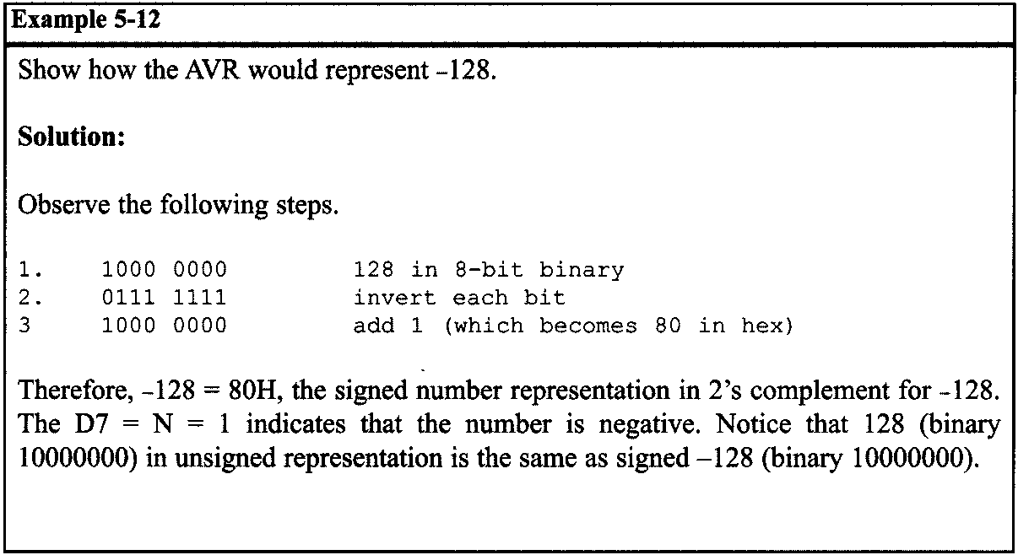
ARITHMATIC, LOGIC INSTRUCTIONS AND PROGRAMS 5.2: SIGNED NUMBER CONCEPTS AND ….

Slide 24
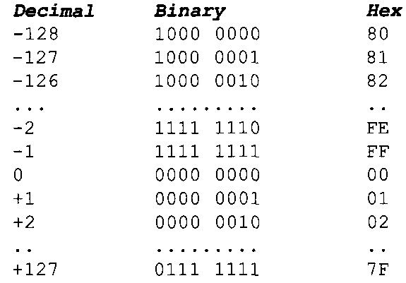
ARITHMATIC, LOGIC INSTRUCTIONS AND PROGRAMS 5.2: SIGNED NUMBER CONCEPTS AND ….
From the examples above, it is clear that the range of byte-sized negative numbers is -1 to -128. The following lists byte-sized signed number ranges:

Slide 25
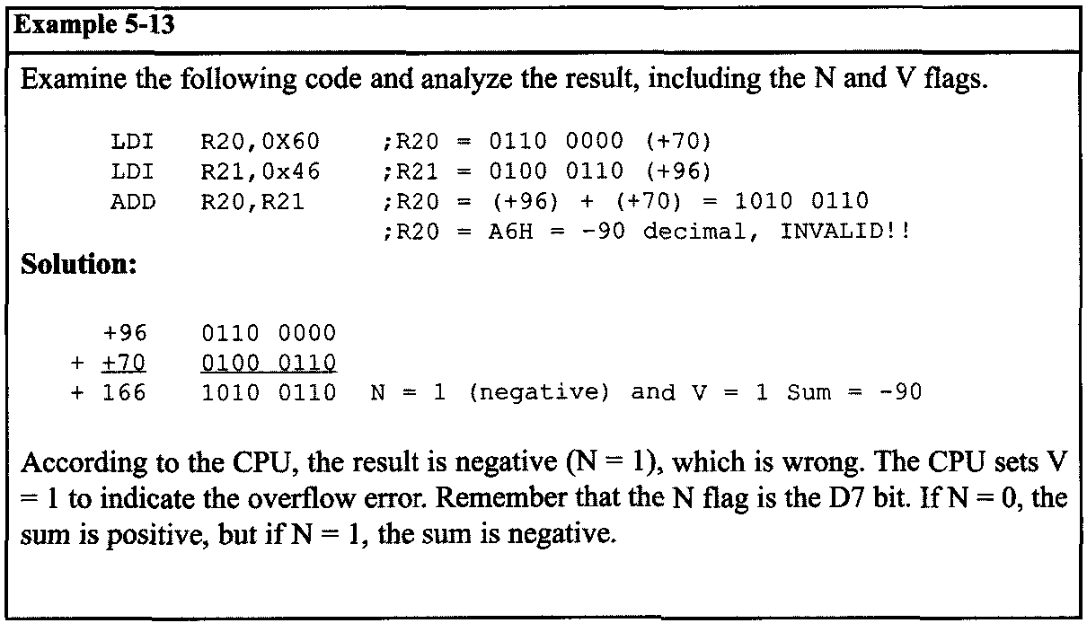
ARITHMATIC, LOGIC INSTRUCTIONS AND PROGRAMS 5.2: SIGNED NUMBER CONCEPTS AND ….
Overflow problem in signed number operations
What is an overflow? If the result of an operation on signed numbers is too large for the register, an overflow has occurred and the programmer must be notified.
Notes:
In Example 5-13, +96 was added to +70 and the result, according to the CPU, was -90. Why? The reason is that the result was larger than what RO could contain. Like all other 8-bit registers, RO could only contain values less than or equal to +127. The designers of the CPU created the overflow flag specifically for the purpose of informing the programmer that the result of the signed number operation is erroneous. The N flag is D7 of the result. If N = 0, the sum is positive (+) and if N = 1, then the sum is negative.

Slide 26
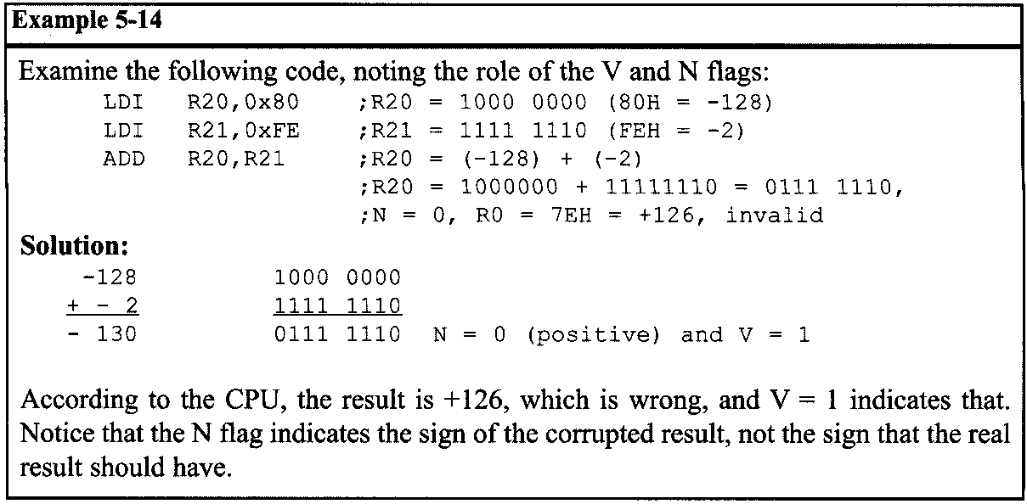
ARITHMATIC, LOGIC INSTRUCTIONS AND PROGRAMS 5.2: SIGNED NUMBER CONCEPTS AND ….
When is the V flag set?
In 8-bit signed number operations, V is set to 1 if either of the following two conditions occurs:
1. There is a carry from D6 to D7 but no carry out of D7 (C = 0).
2. There is a carry from D7 out (C = 1) but no carry from D6 to D7.

Slide 27
ARITHMATIC, LOGIC INSTRUCTIONS AND PROGRAMS 5.2: SIGNED NUMBER CONCEPTS AND ….
Further considerations on the V flag
In the ADD instruction, there are two different conditions. Either the operands have the same sign or the signs of the operands are different.
When we ADD two numbers with different signs, the absolute value of the result is smaller than the operands before executing the ADD instruction. So overflow definitely cannot happen after two operands with different signs are added.
Overflow is possible only when we ADD two operands with the same sign. In this case the absolute value of the result is larger than the operands before executing the ADD instruction. So it is possible that the result will be too large for the register and cause overflow. If we add two numbers with the same sign and the result sign is different, we know that overflow has occurred. That is exactly the way that the CPU knows when to set the V flag. In the AVR the equation of the V flag is as follows:

Slide 28

ARITHMATIC, LOGIC INSTRUCTIONS AND PROGRAMS 5.2: SIGNED NUMBER CONCEPTS AND ….
Further considerations on the V flag
In the AVR the equation of the V flag is as follows:
where Rd7 and Rr7 are the 7th bit of the operands and R7 is the 7th bit of the result.

Slide 29
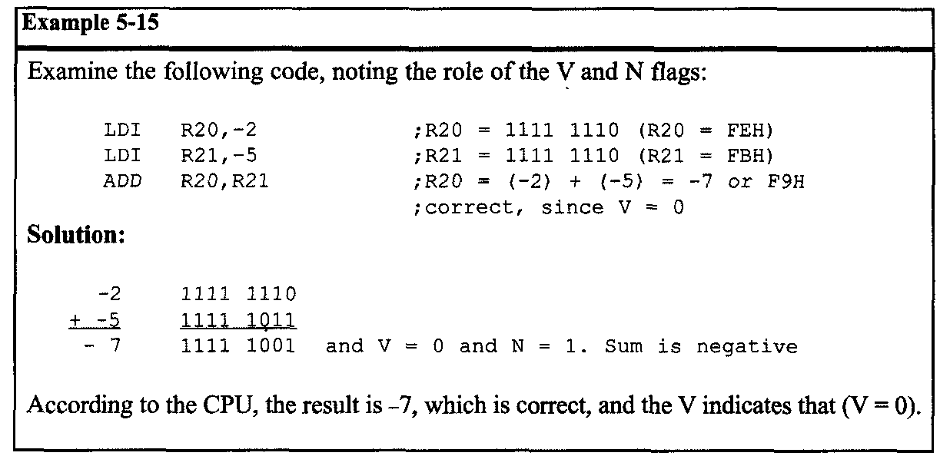
ARITHMATIC, LOGIC INSTRUCTIONS AND PROGRAMS 5.2: SIGNED NUMBER CONCEPTS AND ….

Slide 30
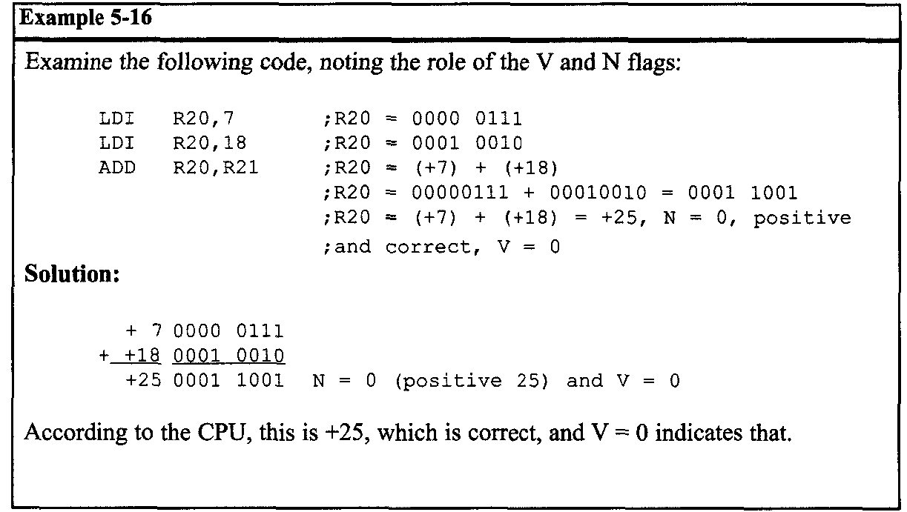
ARITHMATIC, LOGIC INSTRUCTIONS AND PROGRAMS 5.2: SIGNED NUMBER CONCEPTS AND ….

Slide 31
ARITHMATIC, LOGIC INSTRUCTIONS AND PROGRAMS 5.2: SIGNED NUMBER CONCEPTS AND ….
From Examples 5-14 to 5-16, we conclude that in any signed number addition, V indicates whether the result is valid or not. If V = 1, the result is erroneous; if V = 0, the result is valid.
We can state emphatically that in unsigned number addition, the programmer must monitor the status of C (carry flag), and in signed number addition, the V (overflow) flag must be monitored.
In the AVR, instructions such as BRCS and BRCC allow the program to branch right after the addition of unsigned numbers according to the value of C flag.
There are also the BRVC and the BRVS instructions for the V flag that allow us to correct the signed number error. We also have two branch instructions for the N flag (negative), BRPL and BRMI.

Slide 32
ARITHMATIC, LOGIC INSTRUCTIONS AND PROGRAMS 5.2: SIGNED NUMBER CONCEPTS AND ….
What is the difference between the N and S flags?
In signed numbers the N flag represents the D7 bit of the result. It is called the Negative flag.
In operations on signed numbers, overflow is possible. Overflow corrupts the result and negates the sign bit. So if you ADD two positive numbers, in case of overflow, the N flag would be 1 showing that the result is negative! The S flag helps you to know the sign of the real result. It checks the V flag in addition to the D7 bit.
If V = 0, it shows that overflow has not occurred and the S flag will be the same as D7 to show the sign of the result.
If V = 1, it shows that overflow has occurred and the S flag will be opposite to the D7 to show the sign of the real (not the corrupted) result.

Slide 33
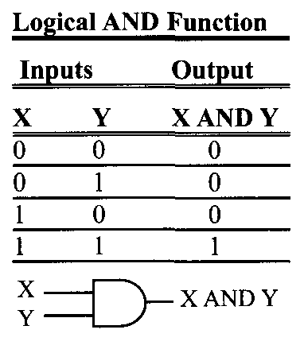
ARITHMATIC, LOGIC INSTRUCTIONS AND PROGRAMS 5.3: LOGIC AND COMPARE INSTRUCTIONS
AND
AND Rd,Rr ;Rd = Rd AND Rr
This instruction will perform a logical AND on the two operands and place the result in the left-hand operand. There is also the “ANDI Rd,k” instruction in which the right-hand operand can be a constant value. The AND instruction will affect the Z, S, and N flags.
Notes:
The AND instruction is often used to mask (set to 0) certain bits of an operand.

Slide 34
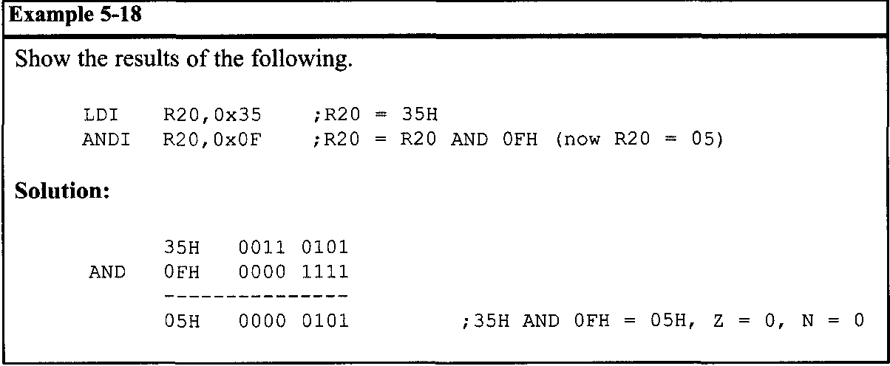
ARITHMATIC, LOGIC INSTRUCTIONS AND PROGRAMS 5.3: LOGIC AND COMPARE INSTRUCTIONS

Slide 35
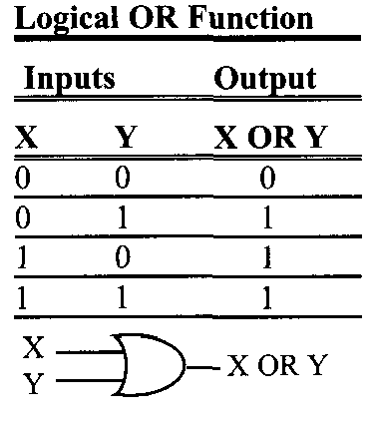
ARITHMATIC, LOGIC INSTRUCTIONS AND PROGRAMS 5.3: LOGIC AND COMPARE INSTRUCTIONS
OR
OR Rd,Rr ;Rd = Rd OR Rr
This instruction will perform a logical OR on the two operands and place the result in the left-hand operand. There is also the “ORI Rd,k” instruction in which the right-hand operand can be a constant value. The OR instruction will affect the Z, S, and N flags.
Notes:
The OR instruction can be used to set certain bits of an operand to 1.

Slide 36
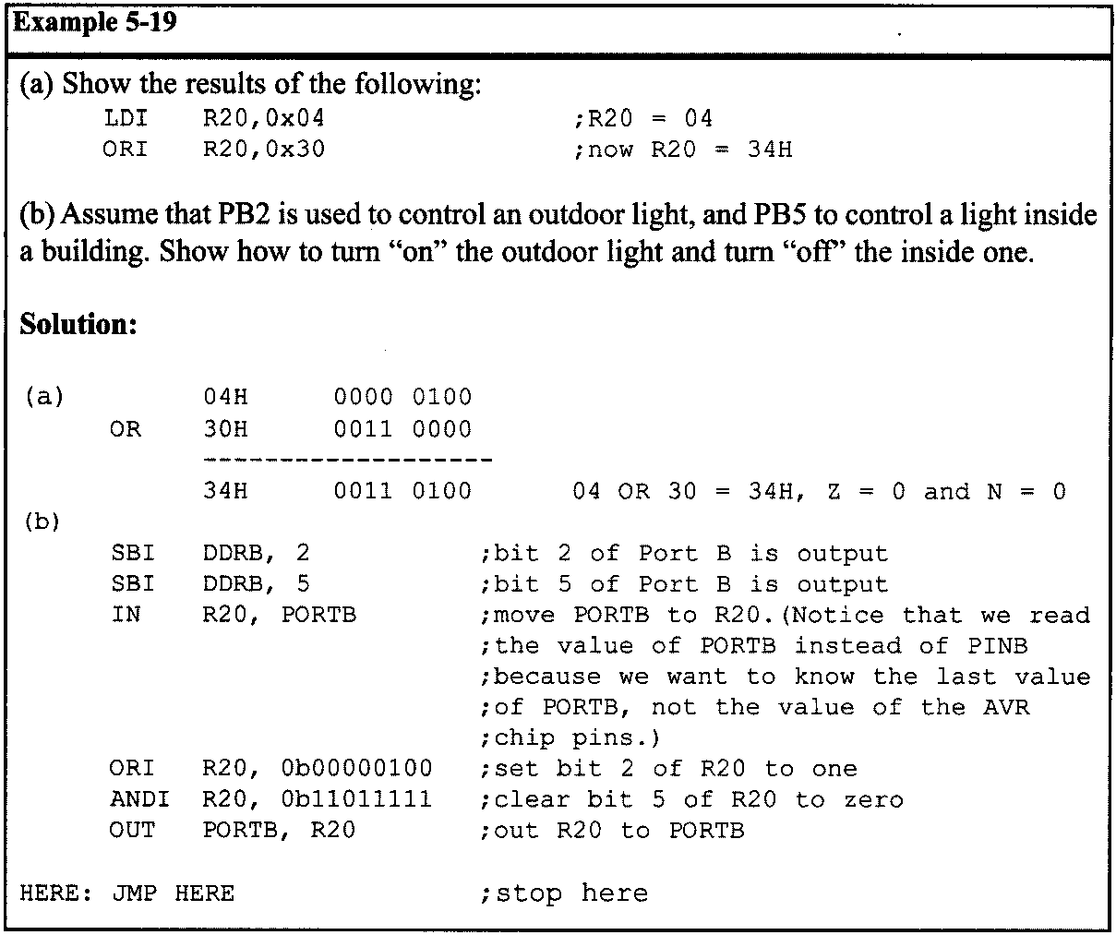
ARITHMATIC, LOGIC INSTRUCTIONS AND PROGRAMS 5.3: LOGIC AND COMPARE INSTRUCTIONS

Slide 37
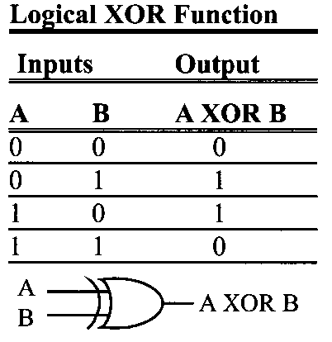
ARITHMATIC, LOGIC INSTRUCTIONS AND PROGRAMS 5.3: LOGIC AND COMPARE INSTRUCTIONS
eOR Rd,Rr ;Rd = Rd XOR Rr
This instruction will perform a logical EX-OR on the two operands and place the result in the left-hand operand. There is also the “eOR” instruction will affect the Z, S, and N flags.
Notes:
This instruction will perform a logical EX-OR on the two operands and place the result in the left-hand operand. The EX-OR instruction will affect the Z, S, and N flags. N is D7 of the result and Z = 1 if the result is zero.

Slide 38
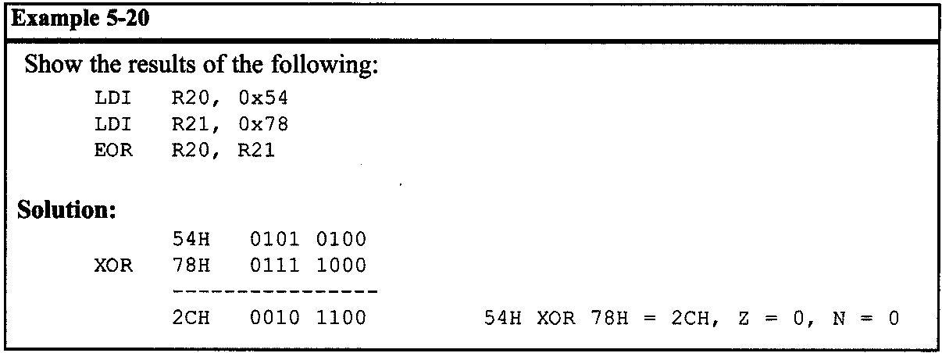
ARITHMATIC, LOGIC INSTRUCTIONS AND PROGRAMS 5.3: LOGIC AND COMPARE INSTRUCTIONS

Slide 39
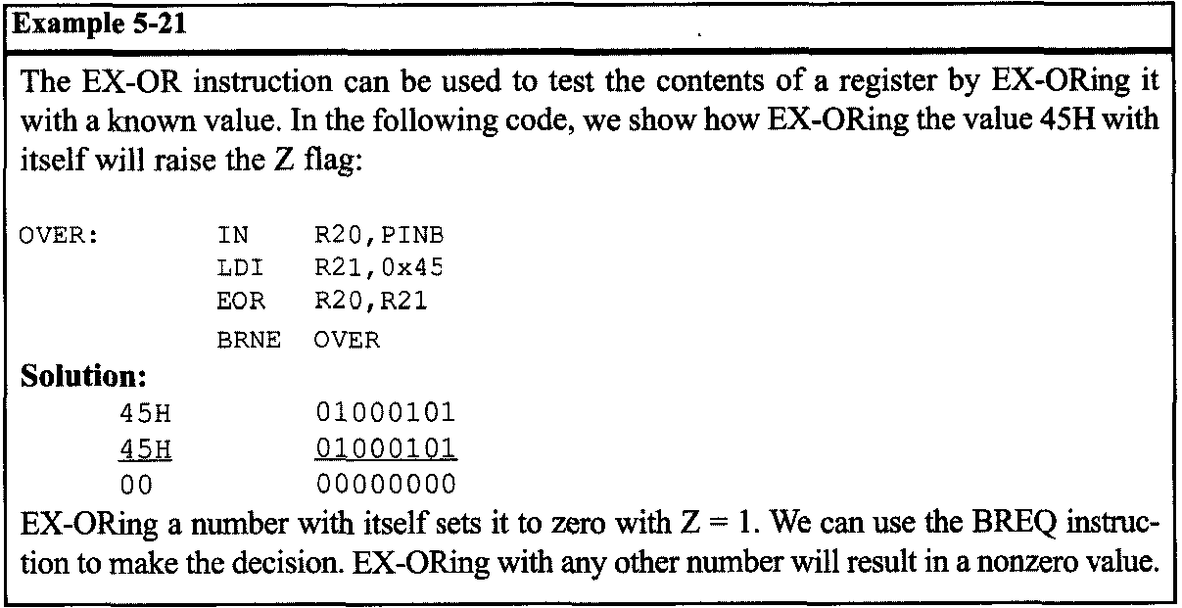
ARITHMATIC, LOGIC INSTRUCTIONS AND PROGRAMS 5.3: LOGIC AND COMPARE INSTRUCTIONS
EX-OR can also be used to see if two registers have the same value. The "EOR R0,R1" instruction will EX-OR the R0 register and R1, and put the result in R0.
Notes:
If both registers have the same value, 00 is placed in R0 and the Z flag is set (Z = 1). Then, we can use the BREQ or BRNE instruction to make a decision based on the result.

Slide 40
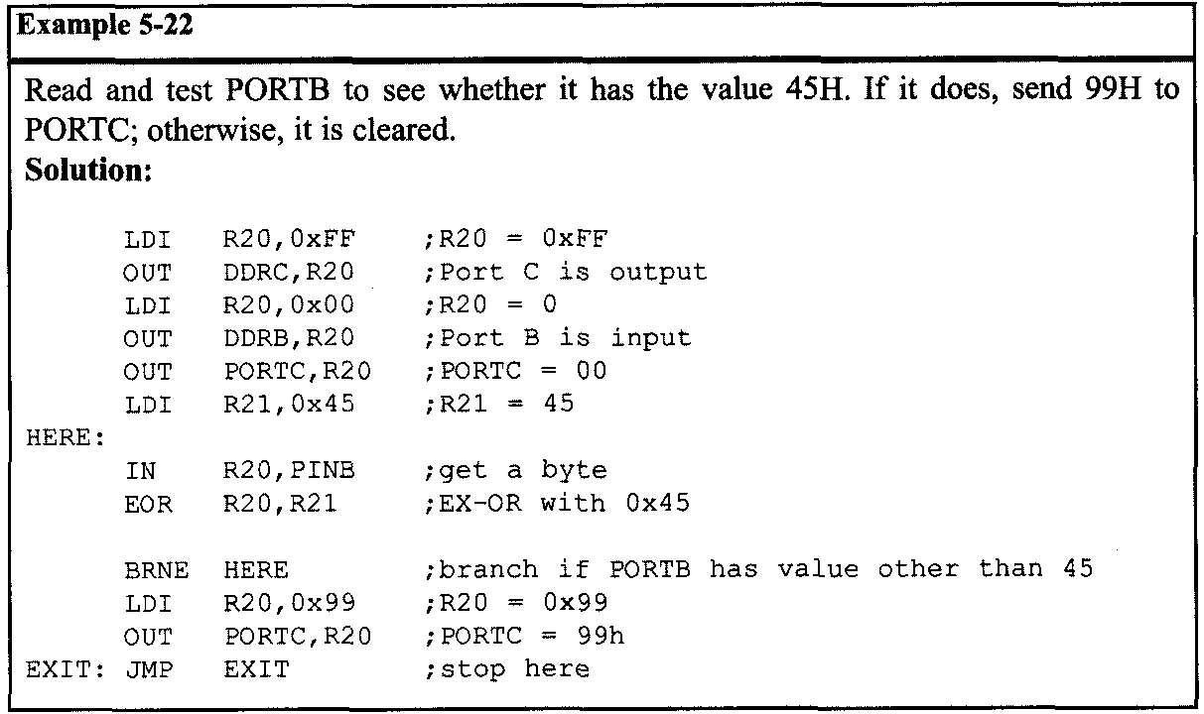
ARITHMATIC, LOGIC INSTRUCTIONS AND PROGRAMS 5.3: LOGIC AND COMPARE INSTRUCTIONS

Slide 41
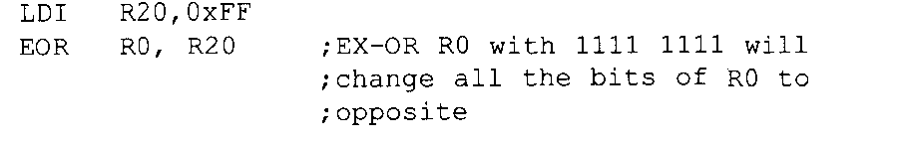
ARITHMATIC, LOGIC INSTRUCTIONS AND PROGRAMS 5.3: LOGIC AND COMPARE INSTRUCTIONS
Another widely used application of EX-OR is to toggle the bits of an operand. The following code demonstrates how to use EX-OR to toggle the bits of an operand.

Slide 42
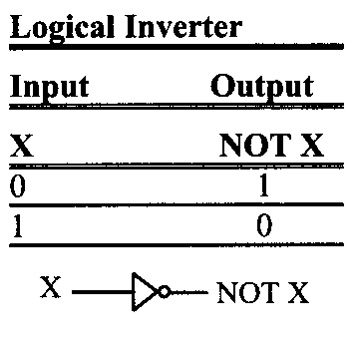
ARITHMATIC, LOGIC INSTRUCTIONS AND PROGRAMS 5.3: LOGIC AND COMPARE INSTRUCTIONS
COM (complement)
This instruction complements the contents of a register. The complement action changes the 0s to 1s, and the 1s to 0s. This is also called 1’s complement.

Slide 43
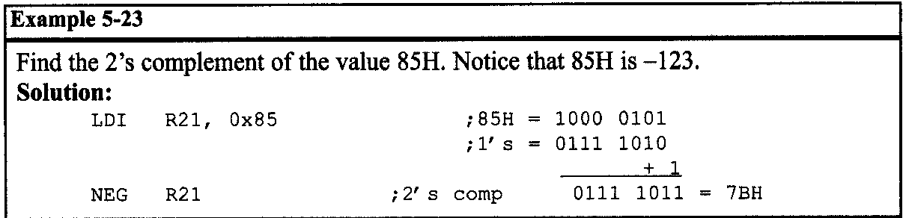
ARITHMATIC, LOGIC INSTRUCTIONS AND PROGRAMS 5.3: LOGIC AND COMPARE INSTRUCTIONS
NEG (negate)
This instruction takes the 2's complement of a register.

Slide 44
ARITHMATIC, LOGIC INSTRUCTIONS AND PROGRAMS 5.3: LOGIC AND COMPARE INSTRUCTIONS
Compare instructions
CP Rd,Rr
The AVR has the CP instruction for the compare operation. The compare instruction is really a subtraction, except that the values of the operands do not change. There is also the “CPI Rd, k” instruction in which the right-hand operand can be a constant value.
Notes:
The AVR has some conditional branch instructions that can be used after the CP instruction to make decisions based on the result of the CP instruction.

Slide 45
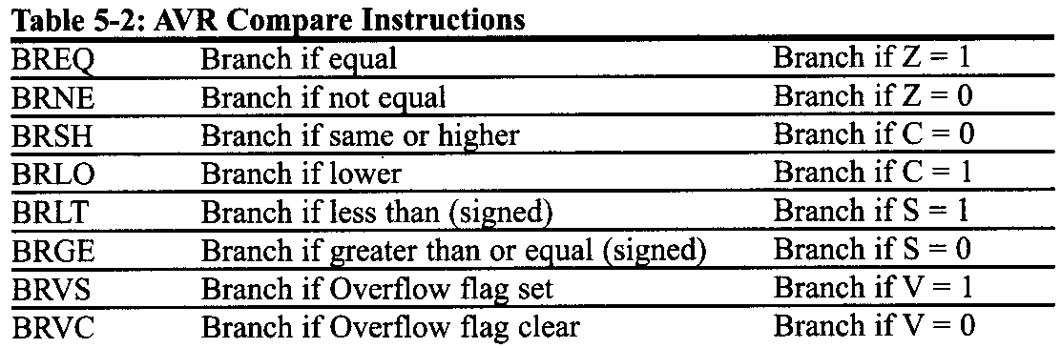
ARITHMATIC, LOGIC INSTRUCTIONS AND PROGRAMS 5.3: LOGIC AND COMPARE INSTRUCTIONS
Conditional branch instructions
As we studied in Chapter 3, conditional branches alter the flow of control if a condition is true. In the AVR there are at least two conditional jumps for each flag of the status register.

Slide 46

ARITHMATIC, LOGIC INSTRUCTIONS AND PROGRAMS 5.3: LOGIC AND COMPARE INSTRUCTIONS
BREQ and BRNE instructions
The BREQ makes decisions based on the Z flag. If Z = 1 the BREQ instruction branches
The BRNE instruction, like the BREQ, makes decisions based on the Z flag, but it branches when Z = 0.
Notice that the BREQ and BRNE instructions can be used for both signed, and unsigned numbers.

Slide 47
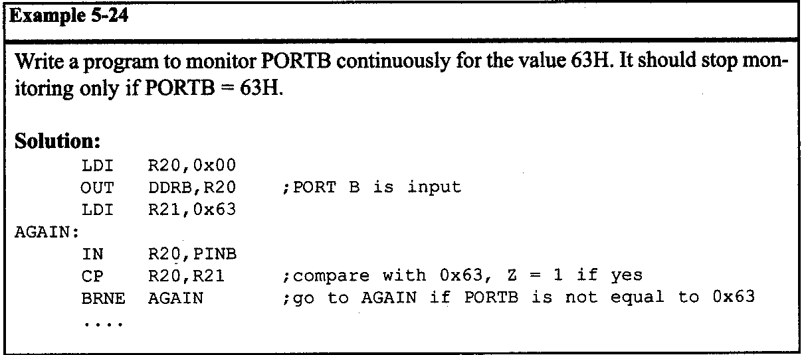
ARITHMATIC, LOGIC INSTRUCTIONS AND PROGRAMS 5.3: LOGIC AND COMPARE INSTRUCTIONS

Slide 48
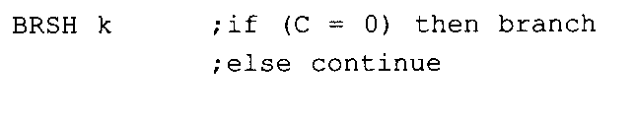
ARITHMATIC, LOGIC INSTRUCTIONS AND PROGRAMS 5.3: LOGIC AND COMPARE INSTRUCTIONS
BRSH and BRLO instructions
The BRSH makes decisions based on the C flag. If C = 0 the CPU will jump.
The BRLO instruction, like the BRSH, makes decisions based on the C flag, but it branches when C = 1.

Slide 49
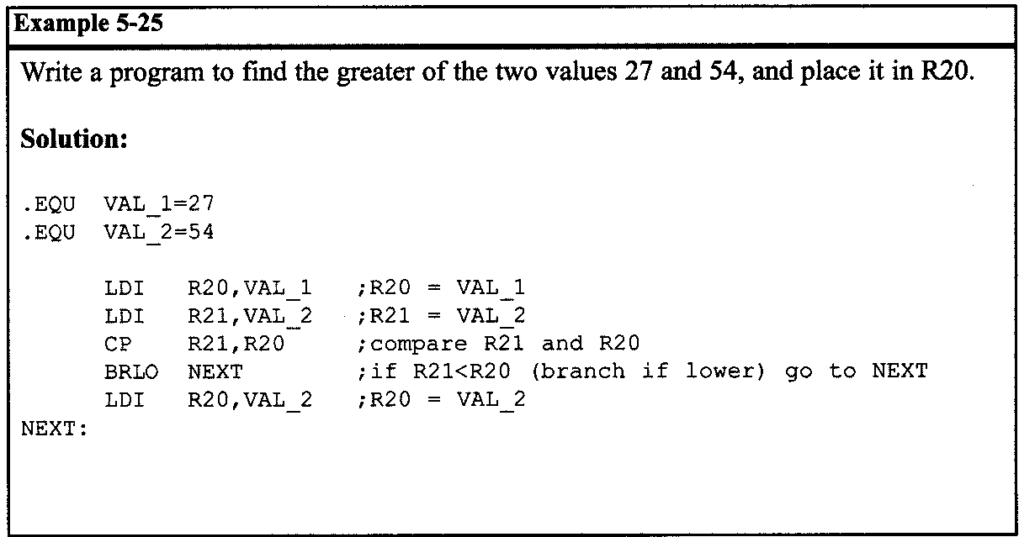
ARITHMATIC, LOGIC INSTRUCTIONS AND PROGRAMS 5.3: LOGIC AND COMPARE INSTRUCTIONS

Slide 50
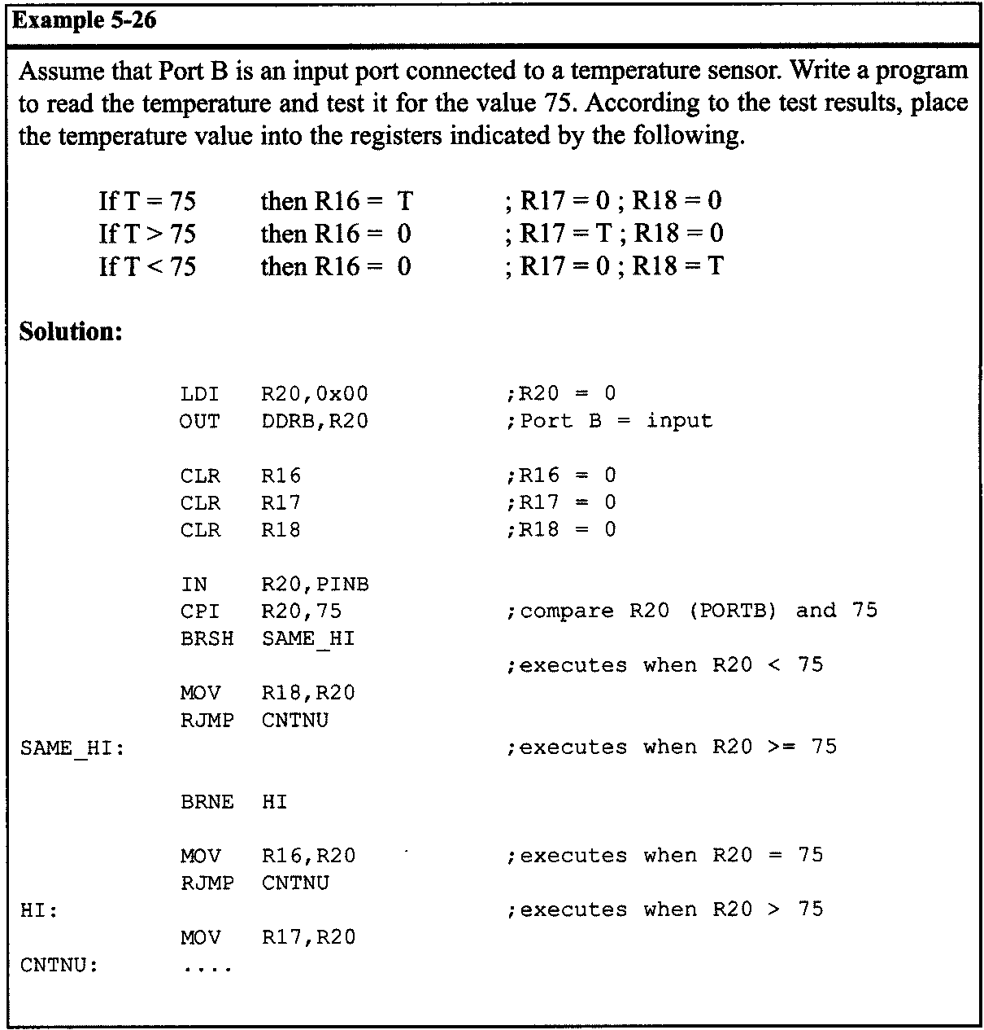
ARITHMATIC, LOGIC INSTRUCTIONS AND PROGRAMS 5.3: LOGIC AND COMPARE INSTRUCTIONS

Slide 51
ARITHMATIC, LOGIC INSTRUCTIONS AND PROGRAMS 5.3: LOGIC AND COMPARE INSTRUCTIONS
BRGE and BRLT instructions
The BRGE makes decisions based on the S flag. If S = 0 (which, after the CP instruction for signed numbers, means that the left-hand operand of the CP instruction was greater than or equal to the right-hand operand) the BRGE instruction branches in a forward or backward direction relative to program counter.
The BRLT is like the BRGE, but it branches when S = 1. Notice that the BRGE, and the BRLT are used with signed numbers.

Slide 52
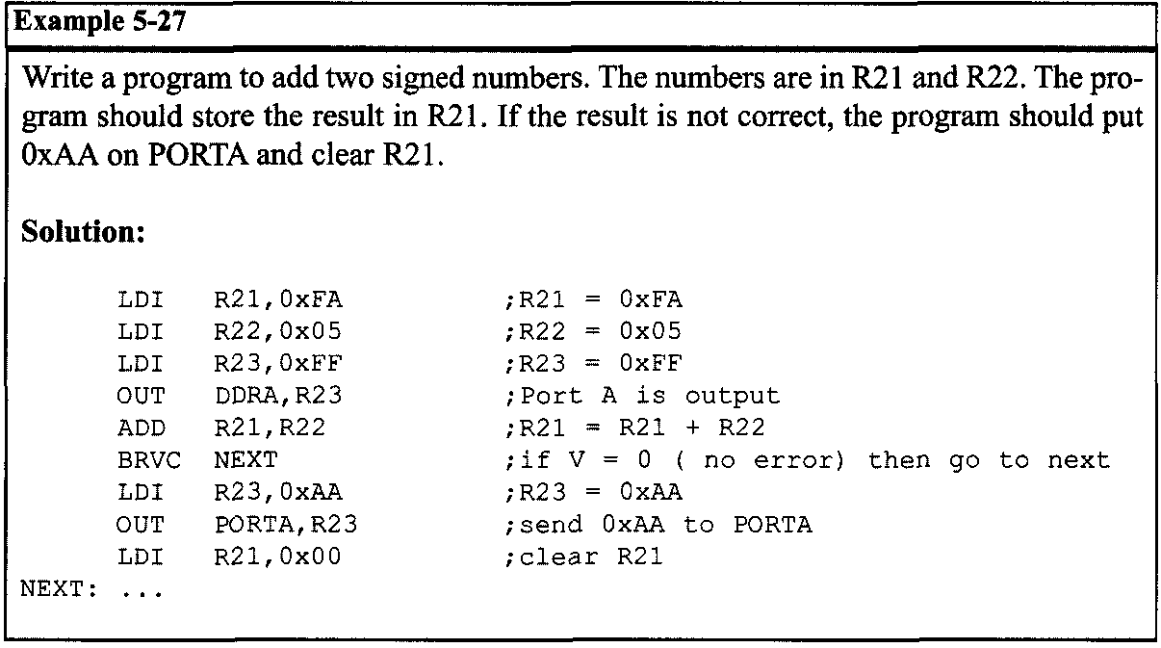
ARITHMATIC, LOGIC INSTRUCTIONS AND PROGRAMS 5.3: LOGIC AND COMPARE INSTRUCTIONS
BRVS and BRVC instructions
As we mentioned before, the V (overflow) flag must be monitored by the programmer to detect overflow and handle the error. The BRVC and BRVS instructions let you check the value of the V flag and change the flow of the program if overflow has occurred.

Slide 53
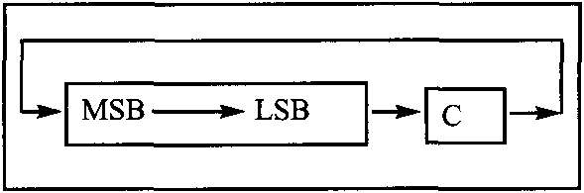
ARITHMATIC, LOGIC INSTRUCTIONS AND PROGRAMS 5.4: ROTATE AND SHIFT INSTRUCTIONS AND DATA SERIALIZATION
Rotating through the carry
There are two rotate instructions in the AVR. They involve the carry flag.
ROR instruction
In the ROR, as bits are rotated from left to right, the carry flag enters the MSB, and the LSB exits to the carry flag. In other words, in ROR the C is moved to the MSB, and the LSB is moved to the C. In reality, the carry flag acts as if it is part of the register, making it a 9-bit register.
Notes:
In the ROR, as bits are rotated from left to right, the carry flag enters the MSB, and the LSB exits to the carry flag. In other words, in ROR the C is moved to the MSB, and the LSB is moved to the C. In reality, the carry flag acts as if it is part of the register, making it a 9-bit register.

Slide 54
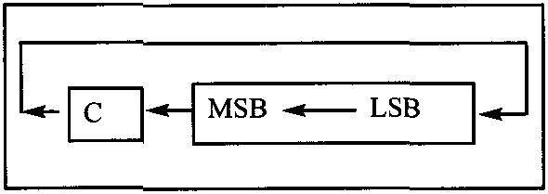
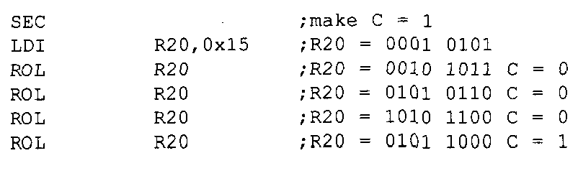
ARITHMATIC, LOGIC INSTRUCTIONS AND PROGRAMS 5.4: ROTATE AND SHIFT INSTRUCTIONS AND DATA SERIALIZATION
ROL instruction
The other rotating instruction is ROL. In ROL, as bits are shifted from right to left, the carry flag enters the LSB, and the MSB exits to the carry flag. In other words, in ROL the C is moved to the LSB, and the MSB is moved to the C. Again, the carry flag acts as if it is part of the register, making it a 9-bit register.
Examine the following code.

Slide 55
ARITHMATIC, LOGIC INSTRUCTIONS AND PROGRAMS 5.4: ROTATE AND SHIFT INSTRUCTIONS AND DATA SERIALIZATION
Serializing data
Serializing data is a way of sending a byte of data one bit at a time through a single pin of the microcontroller. There are two ways to transfer a byte of data serially:
Using the serial port. In using the serial port, programmers have very limited control over the sequence of data transfer.
The second method of serializing data is to transfer data one bit at a time and control the sequence of data and spaces between them. In many new generations of devices such as LCD, ADC, and ROM, the serial versions are becoming popular because they take up less space on a printed circuit board.

Slide 56
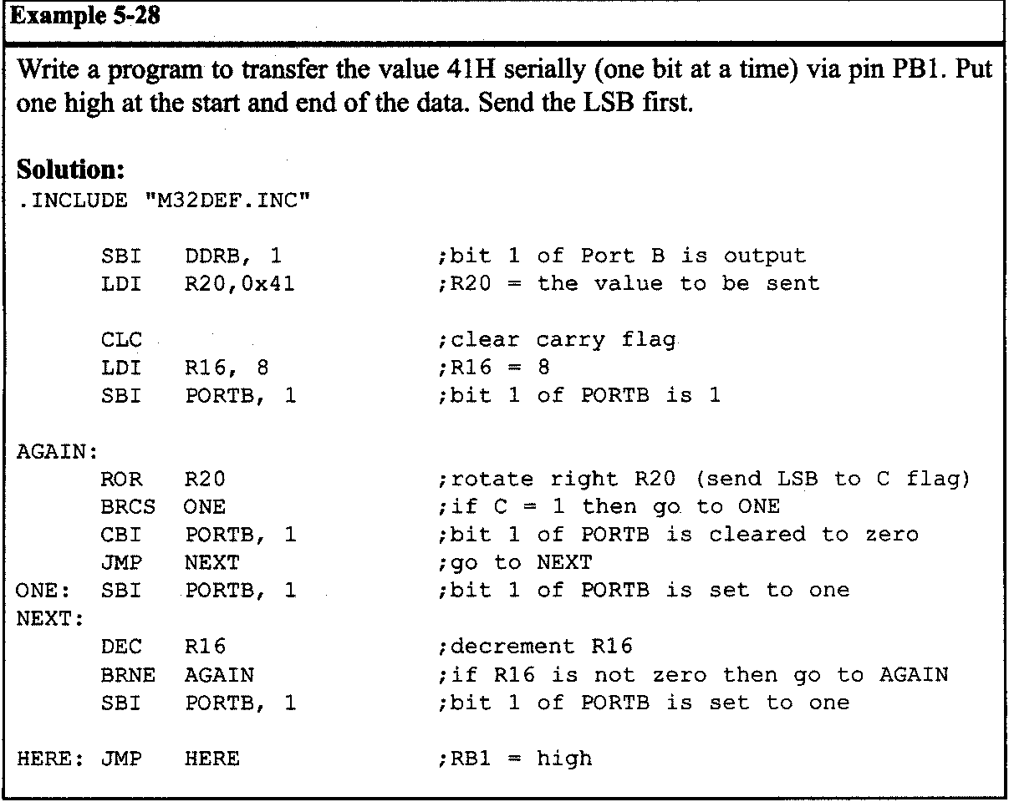
ARITHMATIC, LOGIC INSTRUCTIONS AND PROGRAMS 5.4: ROTATE AND SHIFT INSTRUCTIONS AND DATA SERIALIZATION
Serializing a byte of data
Serializing data is one of the most widely used applications of the rotate instruction. We can use the rotate instruction to transfer a byte of data serially (one bit at a time). Shift instructions can be used for the same job.

Slide 57
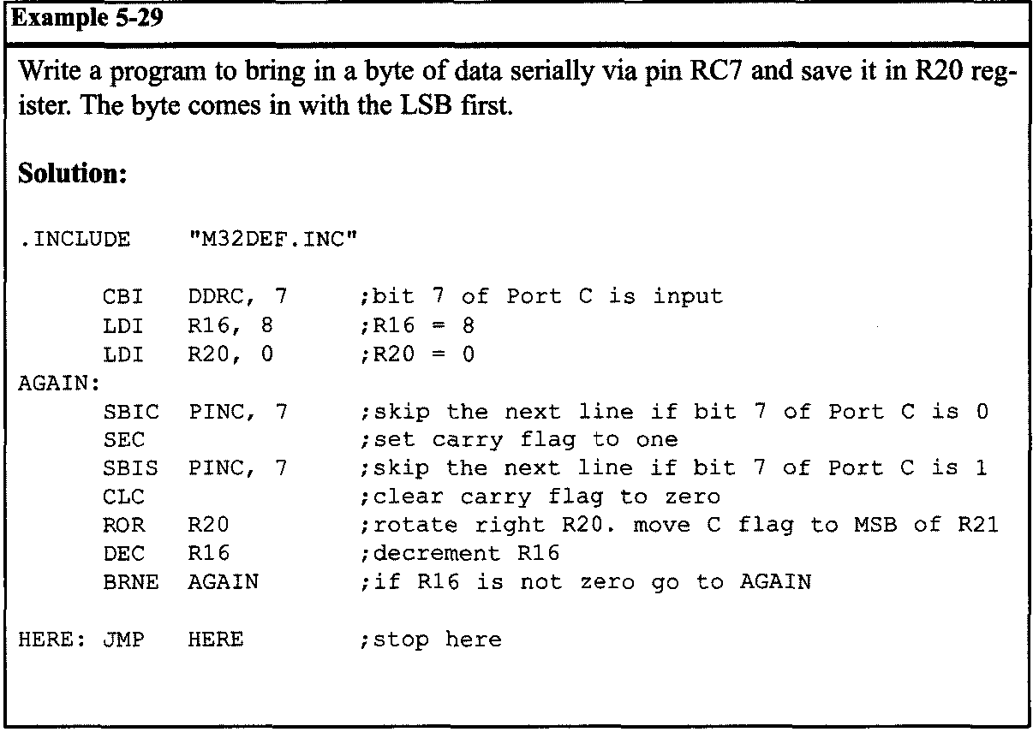
ARITHMATIC, LOGIC INSTRUCTIONS AND PROGRAMS 5.4: ROTATE AND SHIFT INSTRUCTIONS AND DATA SERIALIZATION
Example 5-29 also shows how to bring in a byte of data serially.

Slide 58
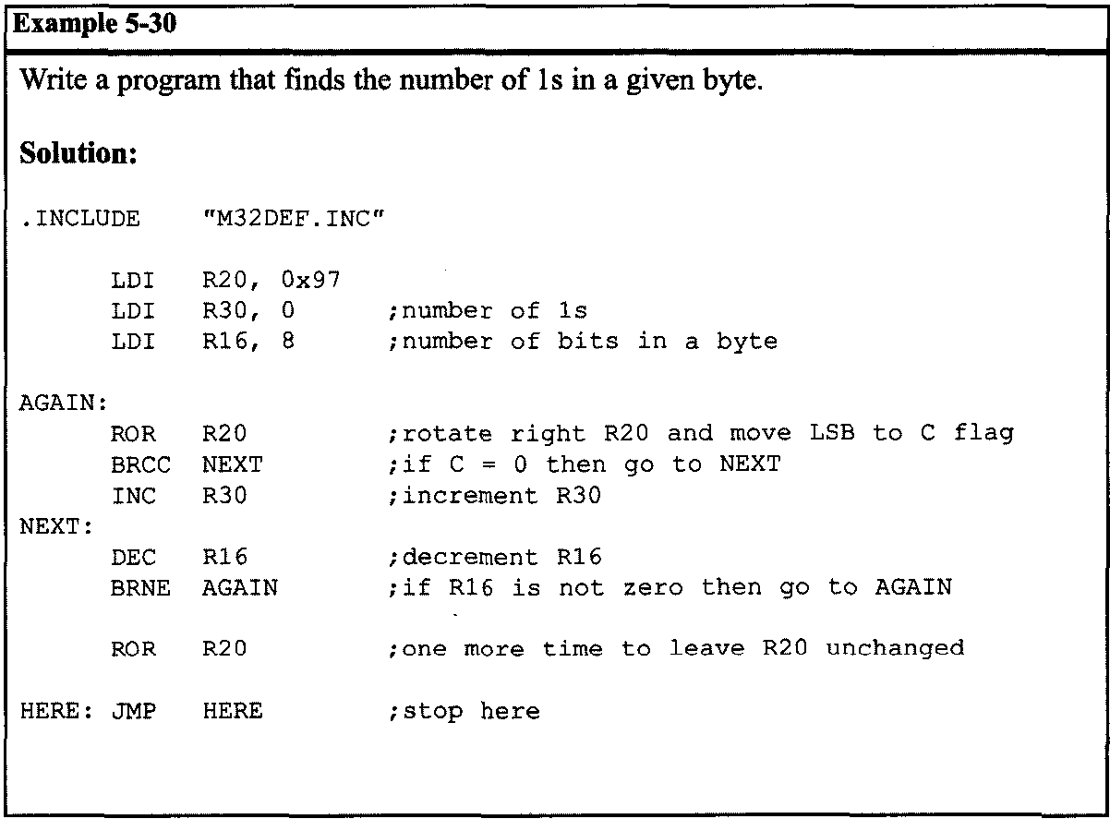
ARITHMATIC, LOGIC INSTRUCTIONS AND PROGRAMS 5.4: ROTATE AND SHIFT INSTRUCTIONS AND DATA SERIALIZATION

Slide 59
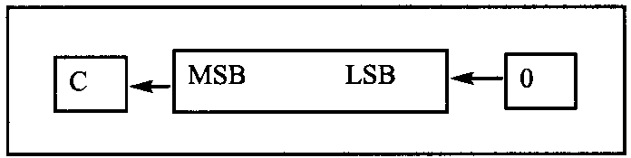

ARITHMATIC, LOGIC INSTRUCTIONS AND PROGRAMS 5.4: ROTATE AND SHIFT INSTRUCTIONS AND DATA SERIALIZATION
Shift instructions
There are three shift instructions in the AVR. All of them involve the carry flag.
LSL instruction
In LSL, as bits are shifted from right to left, enters the LSB, and the MSB exits to the carry flag. In other words, in LSL, is moved to the LSB, and the MSB is moved to the C flag. Notice that this instruction multiplies the content of the register by 2 assuming that after LSL the carry flag is not set.

Slide 60
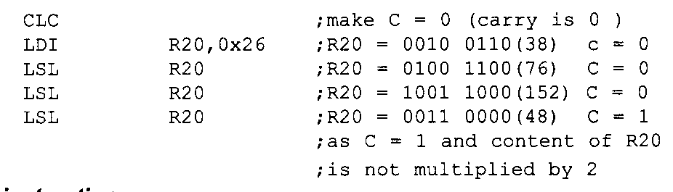
ARITHMATIC, LOGIC INSTRUCTIONS AND PROGRAMS 5.4: ROTATE AND SHIFT INSTRUCTIONS AND DATA SERIALIZATION
Examine the following code.

Slide 61


ARITHMATIC, LOGIC INSTRUCTIONS AND PROGRAMS 5.4: ROTATE AND SHIFT INSTRUCTIONS AND DATA SERIALIZATION
LSR instruction
In LSR, as bits are shifted from left to right, 0 enters the MSB, and the LSB exits to the carry flag. In other words, in LSR, 0 is moved to the MSB, and the LSB is moved to the C flag. Notice that this instruction divides the content of the register by 2 and the carry flag contains the remainder of the division. Examine the following code.
Notes:
remainder of the division.

Slide 62


ARITHMATIC, LOGIC INSTRUCTIONS AND PROGRAMS 5.4: ROTATE AND SHIFT INSTRUCTIONS AND DATA SERIALIZATION
ASR instruction
This instruction is arithmetic shift right. The ASR instruction can divide signed numbers by two. In ASR, as bits are shifted from left to right, the MSB is held constant and the LSB exits to the carry flag. Examine the following code.

Slide 63

ARITHMATIC, LOGIC INSTRUCTIONS AND PROGRAMS 5.4: ROTATE AND SHIFT INSTRUCTIONS AND DATA SERIALIZATION

Slide 64

ARITHMATIC, LOGIC INSTRUCTIONS AND PROGRAMS 5.4: ROTATE AND SHIFT INSTRUCTIONS AND DATA SERIALIZATION

Slide 65


ARITHMATIC, LOGIC INSTRUCTIONS AND PROGRAMS 5.4: ROTATE AND SHIFT INSTRUCTIONS AND DATA SERIALIZATION
SWAP instruction
Another useful instruction is the SWAP instruction. It works on R0-R31. It swaps the lower nibble and the higher nibble. In other words, the lower 4 bits are put into the higher 4 bits, and the higher 4 bits are put into the lower 4 bits.

Slide 66

ARITHMATIC, LOGIC INSTRUCTIONS AND PROGRAMS 5.4: ROTATE AND SHIFT INSTRUCTIONS AND DATA SERIALIZATION

Slide 67

ARITHMATIC, LOGIC INSTRUCTIONS AND PROGRAMS 5.5: BCD AND ASCll CONVERSION
BCD (binary coded decimal) number system
BCD stands for binary coded decimal. BCD is needed because in everyday life we use the digits 0 to 9 for numbers, not binary or hex numbers. binary representation of 0 to 9 is called BCD. In computer literature, one encounters two terms for BCD numbers: (1) unpacked BCD, and (2) packed BCD.

Slide 68
ARITHMATIC, LOGIC INSTRUCTIONS AND PROGRAMS 5.5: BCD AND ASCll CONVERSION
Unpacked BCD
In unpacked BCD, the lower 4 bits of the number represent the BCD number, and the rest of the bits are 0. For example, "0000 1001" and "0000 0101" are unpacked BCD for 9 and 5, respectively. Unpacked BCD requires 1 byte of memory, or an 8-bit register, to contain it.
Packed BCD
In packed BCD, a single byte has two BCD numbers in it: one in the lower 4 bits, and one in the upper 4 bits. For example, "0101 1001" is packed BCD for 59H. Only 1 byte of memory is needed to store the packed BCD operands. Thus, one reason to use packed BCD is that it is twice as efficient in storing data.
Notes:
In packed BCD, a single byte has two BCD numbers in it: one in the lower 4 bits, and one in the upper 4 bits. For example, "0101 1001" is packed BCD for 59H. Only 1 byte of memory is needed to store the packed BCD operands. Thus, one reason to use packed BCD is that it is twice as efficient in storing data.

Slide 69

ARITHMATIC, LOGIC INSTRUCTIONS AND PROGRAMS 5.5: BCD AND ASCll CONVERSION
ASCll numbers
On ASCII keyboards, when the key “0” is activated, “011 0000” (30H) is provided to the computer. Similarly, 31H (011 0001) is provided for key “1”, and so on.

Slide 70

ARITHMATIC, LOGIC INSTRUCTIONS AND PROGRAMS 5.5: BCD AND ASCll CONVERSION
Packed BCD to ASCII conversion
In many systems we have what is called a real-time clock (RTC). The RTC provides the time of day (hour, minute, second) and the date (year, month, day) continuously, regardless of whether the power is on or off. This data, however, is provided in packed BCD. For this data to be displayed on a device such as an LCD, or to be printed by the printer, it must be in ASCII format.
To convert packed BCD to ASCII, you must first convert it to unpacked BCD. Then the unpacked BCD is tagged with 011 0000 (30H). The following demonstrates converting packed BCD to ASCII.

Slide 71

ARITHMATIC, LOGIC INSTRUCTIONS AND PROGRAMS 5.5: BCD AND ASCll CONVERSION

Slide 72


ARITHMATIC, LOGIC INSTRUCTIONS AND PROGRAMS 5.5: BCD AND ASCll CONVERSION
ASCII to packed BCD conversion
To convert ASCII to packed BCD, you first convert it to unpacked BCD (to get rid of the 3), and then combine it to make packed BCD. For example, for 4 and 7 the keyboard gives 34 and 37, respectively. The goal is to produce 47H or "0100 0111", which is packed BCD.

